Slide 1

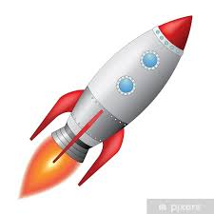
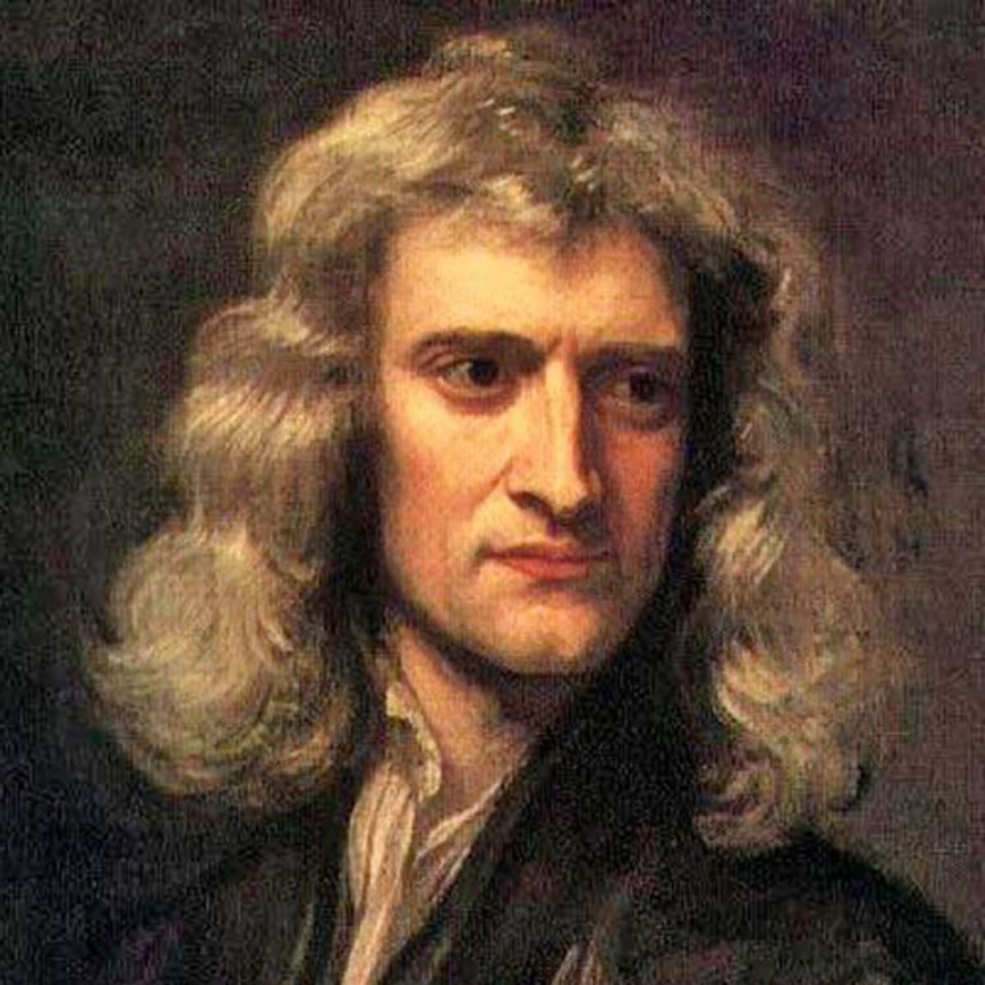
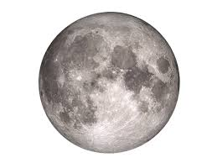
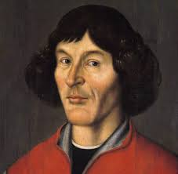
解密神奇的宇宙 Unlocking the secrets of the Universe
Session 2.2: from Einstein to Hawking
Solving the mystery of gravity
Today’s VIP guest list
As we learned in session 1, Newton managed to unify the idea of Earth’s pull on our feet with that of planet movement and indeed interaction between any two bodies with mass – the universal law of gravity was proposed.
But what Newton’s theory did not explain is: what is gravity, where does it come from, and how do we understand it?
In the beginning of 20th century, gravity was understood as a “mysterious force acting at a distance” – scientists had no idea where it comes from. Even worse, certain astronomical observations could not be explained using Newton’s laws. This is when Einstein had his second breakthrough, concerning this time non-inertial reference frames: accelerating systems.
Isaac Newton
Session objectives
Appreciate the equivalence principle between acceleration and gravity
Understand how bodies with mass curve space-time according to general relativity
Use the special relativity postulate to derive how bodies with mass affect time
Discuss why Einstein’s ideas initially met with skepticism
Ponder issues with general relativity and the future directions of key physics research
Key terms
General Relativity
广义相对论
Spacetime
时空
Spacetime curvature
时空扭曲
Non-inertial frame of reference
非惯性参考坐标系
Quantum Gravity
两字引力
Black Hole
黑洞

Slide 2

解密神奇的宇宙 Unlocking the Secrets of the Universe
Non-inertial frame of reference
非惯性坐标系
A frame of reference that is accelerating. For example, an elevator can be a non-inertial reference frame. When you jump out of an airplane before opening your parachute, you are also a non-inertial reference frame.
Equivalence Principle
等效原理
Gravitational pull and acceleration are non-distinguishable
“What” is gravity?
Newton’s laws work great and we can use the universal law of gravity to not only explain movement of celestial bodies, but even build spaceships to take humans to the Moon and other planets.
But Newton’s law of gravity does not really explain “why” gravity works – how do 2 bodies separated by great distances in space “know” about each other and that they should attract the other body?
Measuring your weight in an elevator
When you are traveling in an elevator accelerating down, how much would you weigh if you stood on top an electronic weigh?
What if the elevator were accelerating upward?
Where am I?
Imagine you hibernate for a few centuries to “see the future world” (don’t try this at home!!) and when you wake up, you realize that you are in a room without any windows.
You can walk normally around the room, and it feels like you are on Earth. But unless you manage to get out or find a window, can you tell for sure if you are on Earth, or traveling upwards with acceleration equal to Earth’s gravitational pull?
Important term: Equivalence Principle（等效原理）
Accelerating is equivalent to being pulled by gravity of some body. In other words, to you they seem exactly the same
What is the path that the light ray will take, then?
According to Newton’s theory, light always travels in straight lines.
Is this compatible with equivalence principle?
What would be the curve that light travels along in a non-inertial (accelerating) system, for example on Earth’s surface or onboard a spaceship accelerating “upwards”?
Can we reconcile this with Newton’s intuition?
JinJin STEM Academy

Slide 3
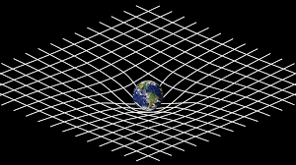
解密神奇的宇宙 Unlocking the Secrets of the Universe
Spacetime
时空
Our known 3 spatial dimensions + time
Spacetime curvature
时空扭曲
In presence of a mass, spacetime “bends” or “curves” creating a certain “shape” (but remember spacetime is actually 3+1 dimensions!)
Bending the spacetime
According to general relativity, space is “curved” in presence of a mass.
1
General Relativity in a nutshell
(by John Wheeler)
“Space-time tells matter how to move
Matter tells space-time how to curve”
What about time in space-time?
Can you use the assumption that light speed is always constant to figure out how General Relativity affects time?
What about “proof”??
Brainstorm how we could prove that general relativity is right
HINT: think about what this theory implies will happen to rays of light. How could we use this to observe astronomical phenomena confirming general relativity to apply?
JinJin STEM Academy

Slide 4
解密神奇的宇宙 Unlocking the Secrets of the Universe
Singularity
奇点
A point (of zero radius) with infinite mass and infinite density.
Black Hole
黑洞
A singularity in space that can emerge when a big enough star collapses onto itself. It has very small radius and effectively infinite density, so its gravitational pull cis very strong close to it,
Black Holes have been confirmed to exist experimentally, and we also hope to be able to create very small black holes in the Large Hadron Collider some day.
Quantum Mechanics
两字力学
Theory explaining phenomena happening at the quantum scale: behavior and interactions of very, very small particles such as electrons (and smaller!)
When General Relativity fails
General Relativity explains a whole lot about gravity, but unfortunately, it still seems incomplete.
ISSUE 1:
Black Holes
General Relativity breaks in presence of black holes
ISSUE 2:
Big Bang
General Relativity does not work at singularities such as the singularity existing when our Universe was created in the Big Bang
ISSUE 3:
Quantum World
General Relativity does not make much sense at very small scales.
1
Quantum Mechanics vs. General Relativity
For very small scales, general relativity does not apply.
But quantum mechanics does not really explain gravity.
What are we missing?
Why do scientists insist that we only have 1 theory to explain everything: small and big?
JinJin STEM Academy

Slide 5
解密神奇的宇宙 Unlocking the Secrets of the Universe
Time travel
We already know about 2 phenomena affecting time:
time dilation, as a consequence of special relativity
mass affecting time as consequence of general relativity
How could we use these principles to “travel in time”?
What would be limitations of such travel?
Could we overcome these limitations somehow?
Session Summary
Equivalence Principle tells us that accelerating is equivalent to being pulled by a massive body with its gravitational pull
General Relativity tells us that gravity “is” the curvature of space-time
General Relativity also implies that time flows different for observers in space and on planets
General Relativity still has some holes in it: it does not really work for black holes, and does not work at quantum scales.
Ponder before next class
Could we use general relativity to travel “faster than light”? Would we actually “travel faster than light”?
Imagine you have a twin sister and you decide to stay on Earth doing some particle physics research, while she travels to a very massive planet, say 10 times larger than the Earth. When she comes back, who will be older, and why?
Is Newton’s principle that “light always travels along the shortest route from A to B” contradicted by general relativity?
Quantum Mechanics explains the world of the tiny particles. Quantum Gravity explains gravity acting on large objects. What happens “on the border” between the “big” and “small” scales? Which rules apply?
JinJin STEM Academy

